Slide 1
Vision for the engagement of the e-Facilitator in School in the Inspiring Science Education environment
Radoslav Yoshinov
Monka Kotseva
Laboratory of Telematics at the Bulgarian Academy of Sciences

Slide 2
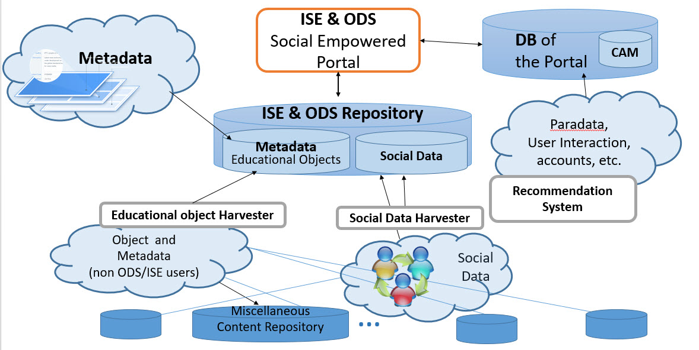
Principal Architecture of the ODS&ISE WEB environment

Slide 3
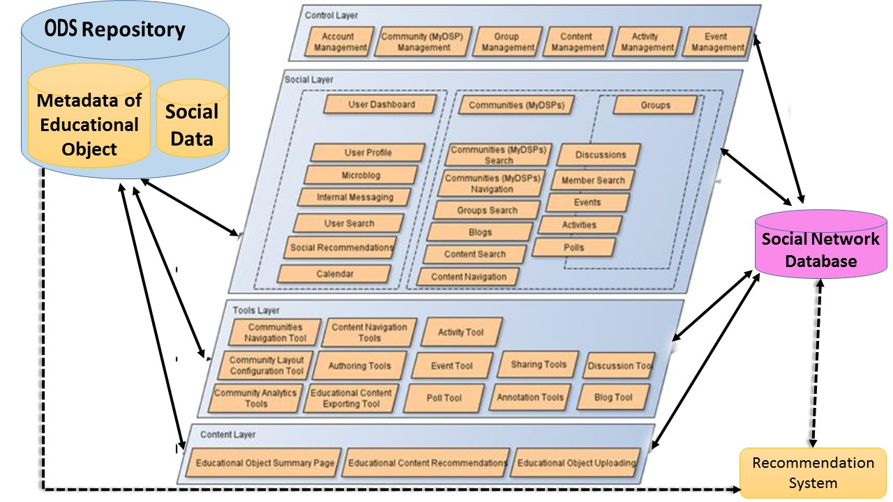
Social network Architecture of the ISE WEB learning environment

Slide 4
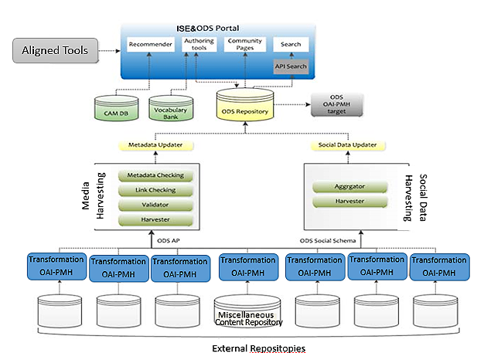
ODS&ISE Portal

Slide 5
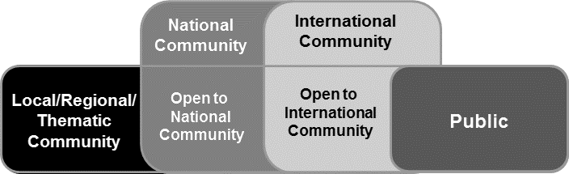
Hierarchy of ISE&ODS
Communities
Relations between the key players as given in the ISE project

Slide 6
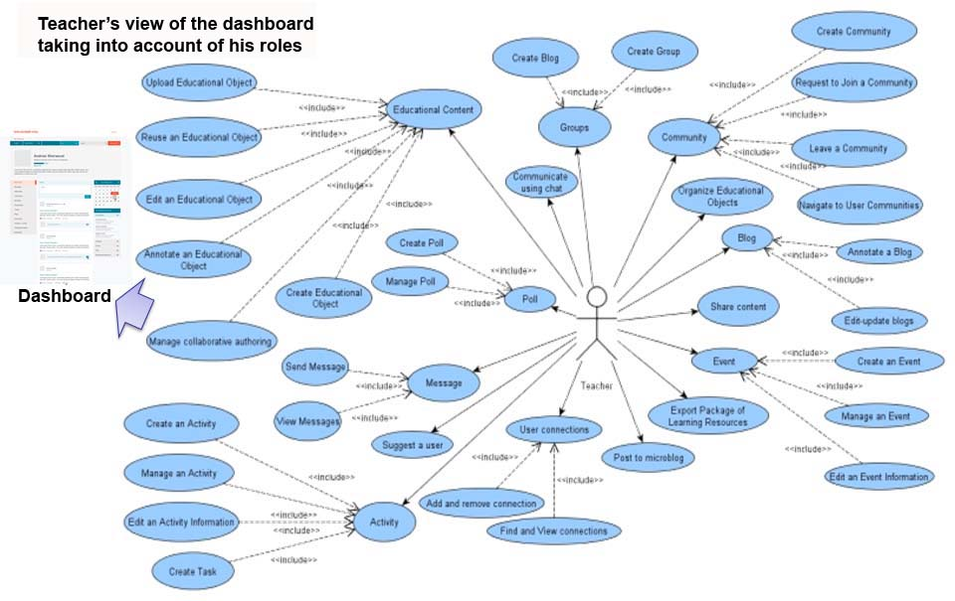

Slide 7
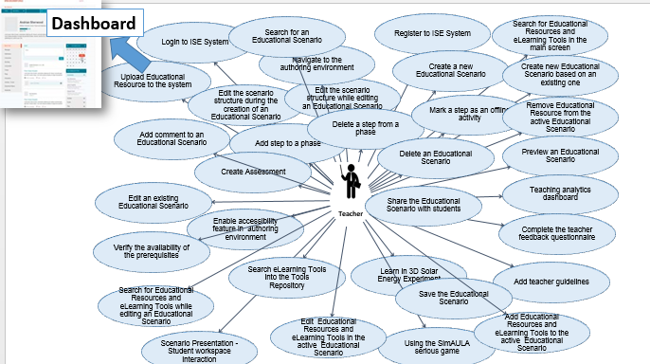

Slide 8
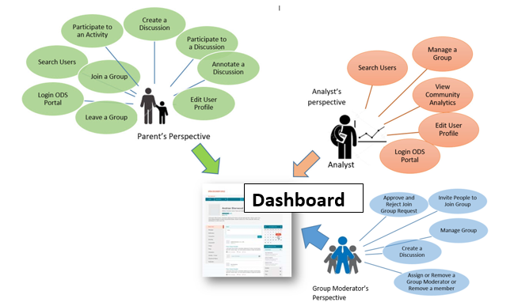
Parents, Analysts, Group Moderator’s roles, viewed as requirements when creating ODS&ISE WEB environment

Slide 9
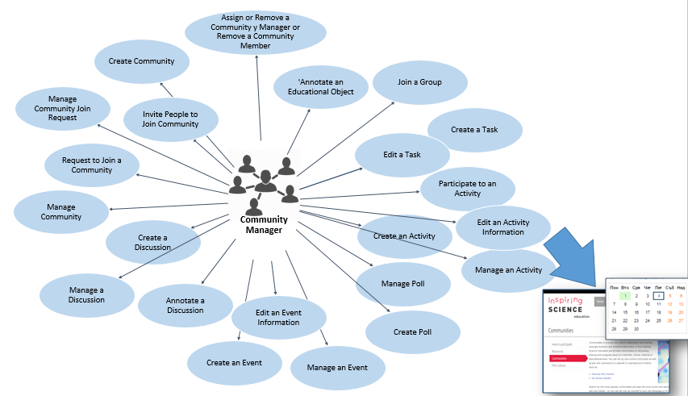
Community manager’s roles, viewed as requirements when creating ODS&ISE WEB environment

Slide 10
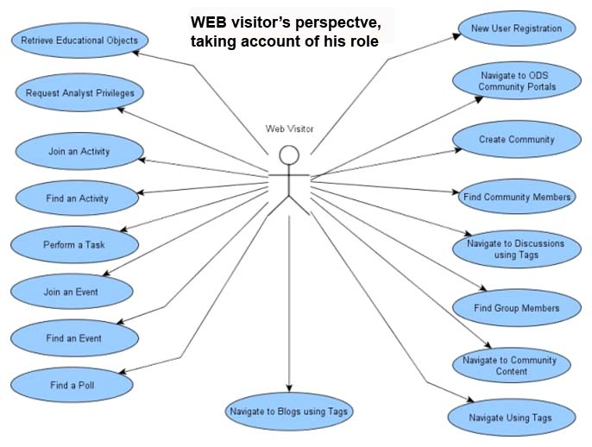

Slide 11
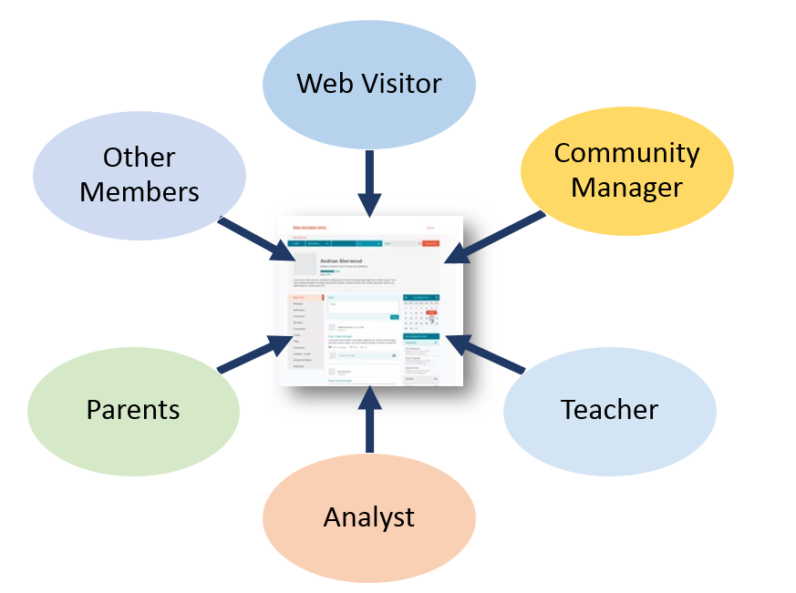

Slide 12
Here are some of the teachers’ roles which they perform throughout the school day and over the course of the school year.
Mediator of learning
Disciplinarian or controller of student behavior
Parent substitute
Confidant to students
Judge of achievement
Organizer of curriculum
Scholar and research specialist
Member of teachers’ organization
Performer of roles in the community
Public servant
Expert in some area of knowledge or skills
ICT Specialist
Community leader
Agent of social change

Slide 13
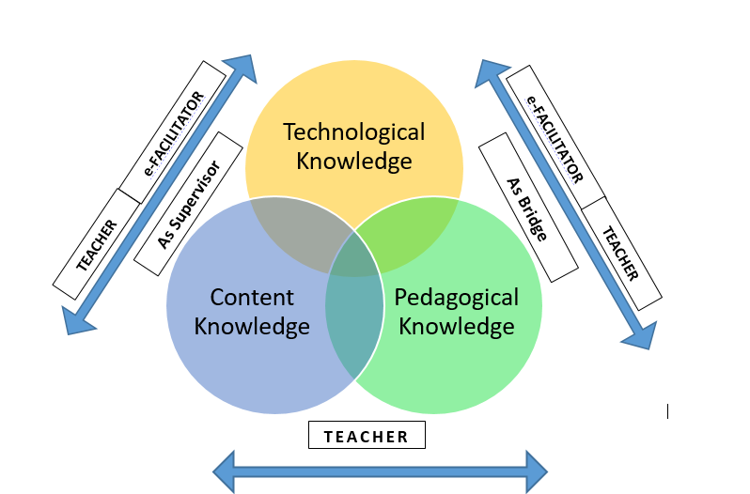
Who is Who in the TPCK model of Mishra&Kohler

Slide 14
How is changed the scheme

Slide 15
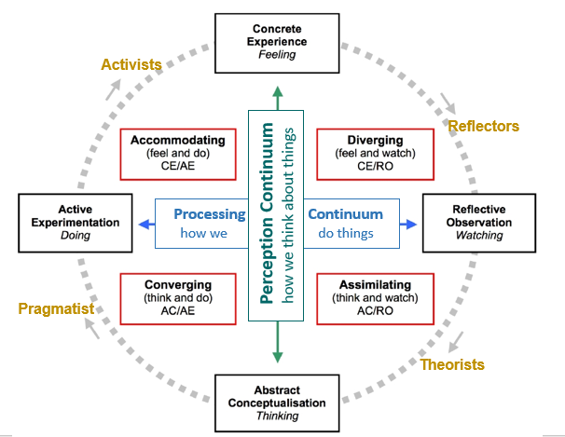
Honey & Mumford’s learning styles and their relation to Kolb’s learning styles

Slide 16
Important are the role functions of the e-facilitator in personalizing the learning process, in both directions ₋ content and pace of learning, matching the education materials to the individual needs of the learner and according to his capacity and style of learning in the context of STEM (science, technology, engineering, and mathematics) education.
This ensures the more complex perception of the relations and flaws: Stakeholder – Content provider; Web visitor – content(LMS,CMS, repositories); Web visitor – Community; Teacher (author) – Content provider; Parent – Content provider, Parent-teacher (author); Community creation –community management; School educational content – administration; Quality assurance; Quant ITive, environment, statistical and event Analysis; Tutoring of Web visitor, Authors, content providers, stakeholders, parents; Functional Help desk for the environment; etc.

Slide 17
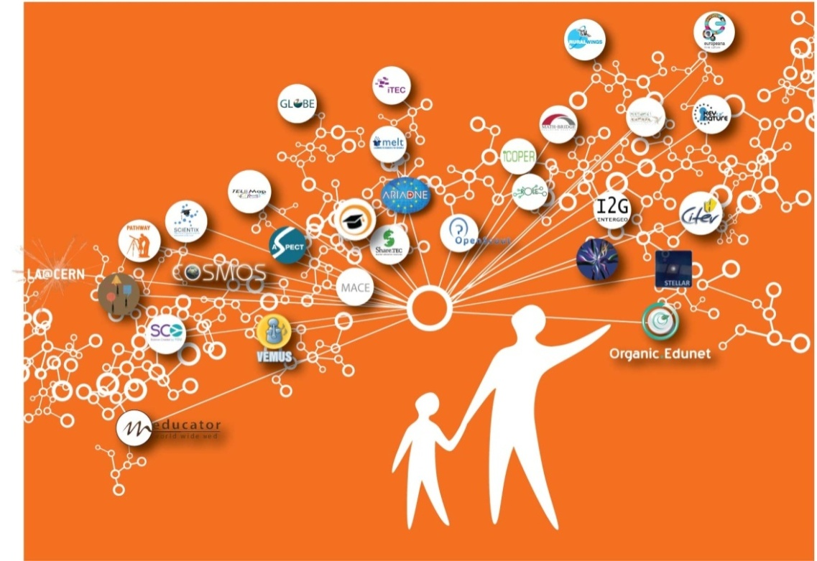
Thanks for your attention !
Assoc. Prof. Radoslav Yoshinov PhD
Bulgaria , Sofia 1113
Acad. G. Bonchev str., Block 8
Laboratory of Telematics - BAS /Director;
Tel. +359 2 979 2896
Mobile +359 888 627190
www.cc.bas.bg; www.bren.bg
Questions?

