Slide 1
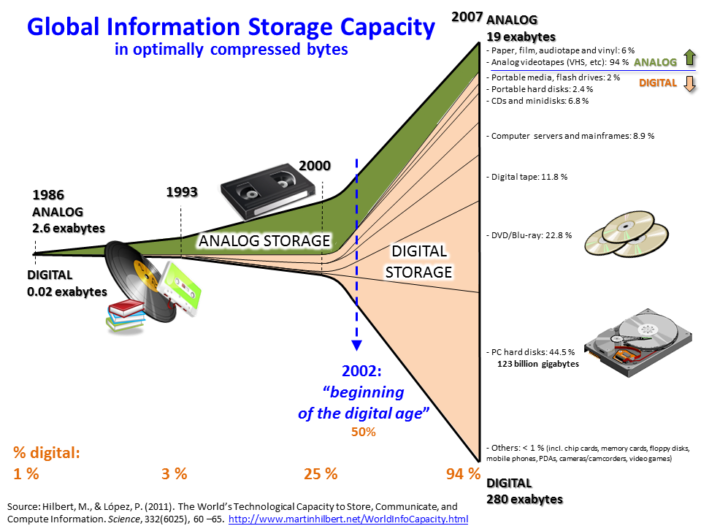
Information Society 2017 and beyond
The Pillars of education
Assoc. Prof. Radoslav Yoshinov
Laboratory of Telematics - BAS

Slide 2

The Information Society of Europe
An INFORMATION SOCIETY is a society where the creation, distribution, use, integration and manipulation of information is a significant economic, political, and cultural activity. Its main driver are digital information and communication technologies, which have resulted in an information explosion and are profoundly changing all aspects of social organization, including the economy, education, health, warfare, government and democracy.
The people who have the means to partake in this form of society are sometimes called DIGITAL CITIZENS.

Slide 3
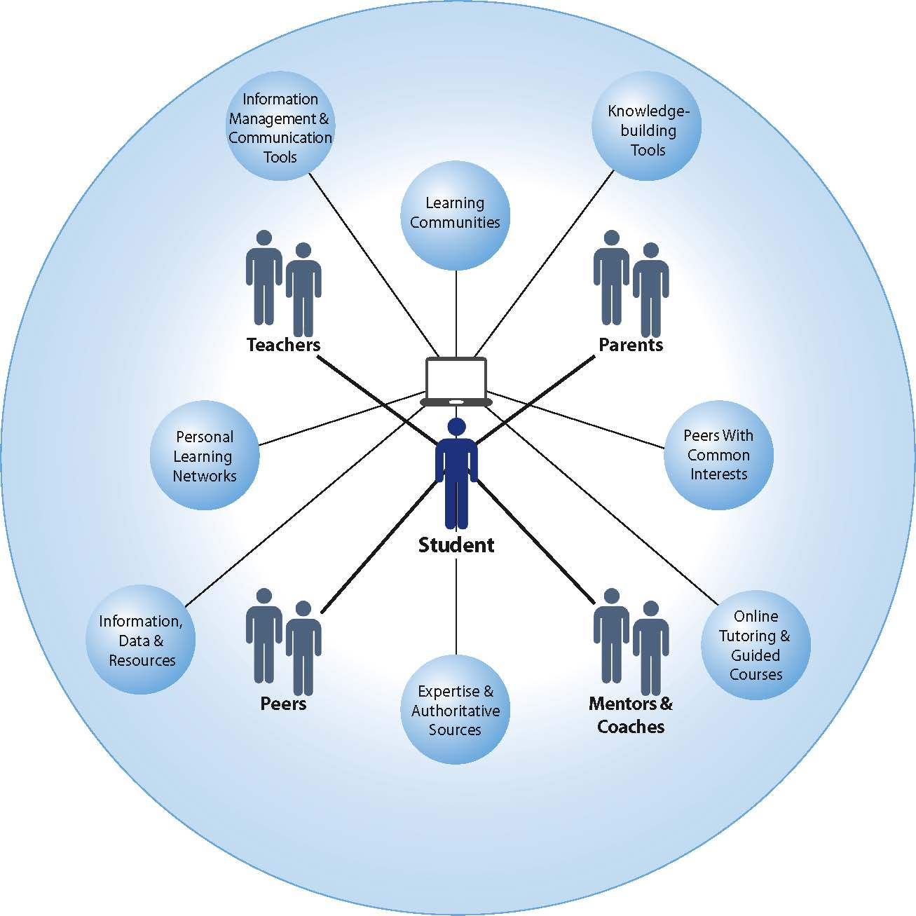
Contemporary Formal education

Slide 4
Pedagogies
Behaviorism
Drill and practice
Non-integrative
tutorials
Integrative tutorials
Socio
constructivism
Cognitive constructivism
Intelligent tutorial system
Simulations
Games
Simulation for multiple users
Virtual education environment VLE
Weblogs
Systems oriented to multiple users
Wiki

Slide 5
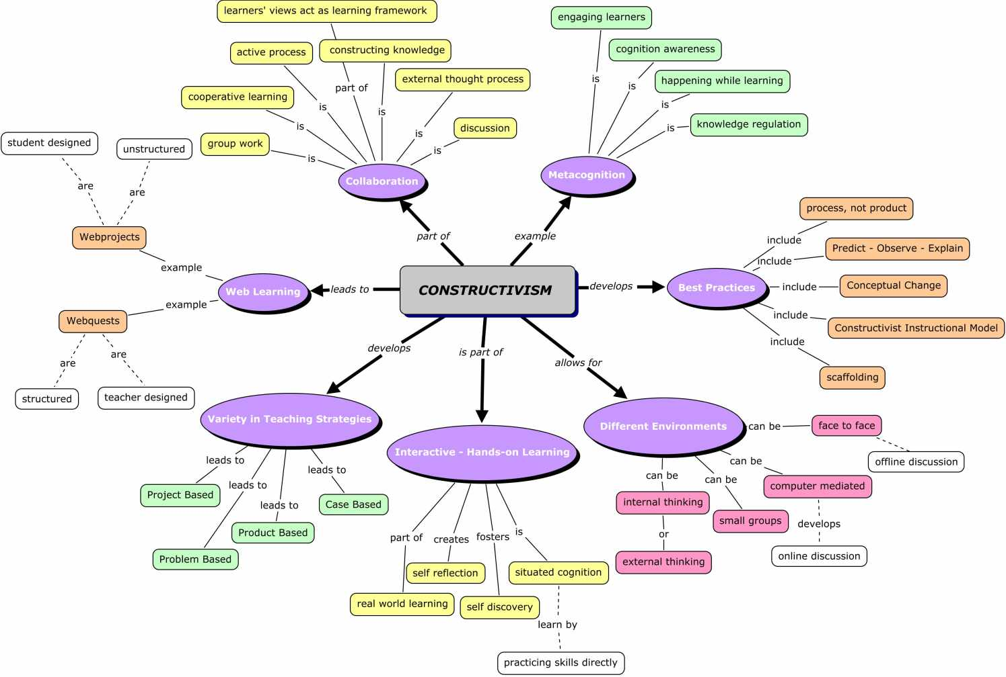
Constructivism
Kognitive
Social
Communal

Slide 6
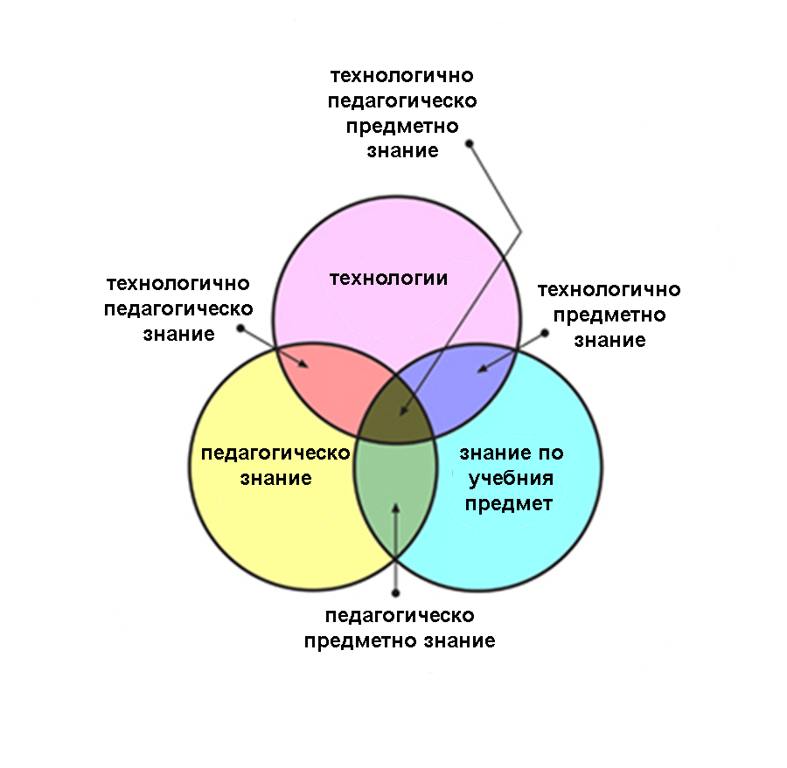
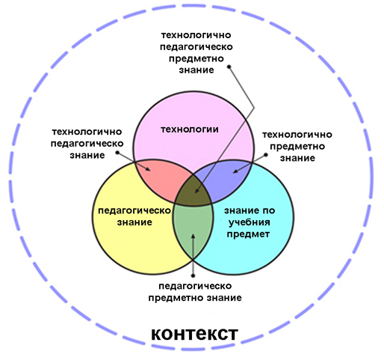
Мишра & Колер

Slide 7
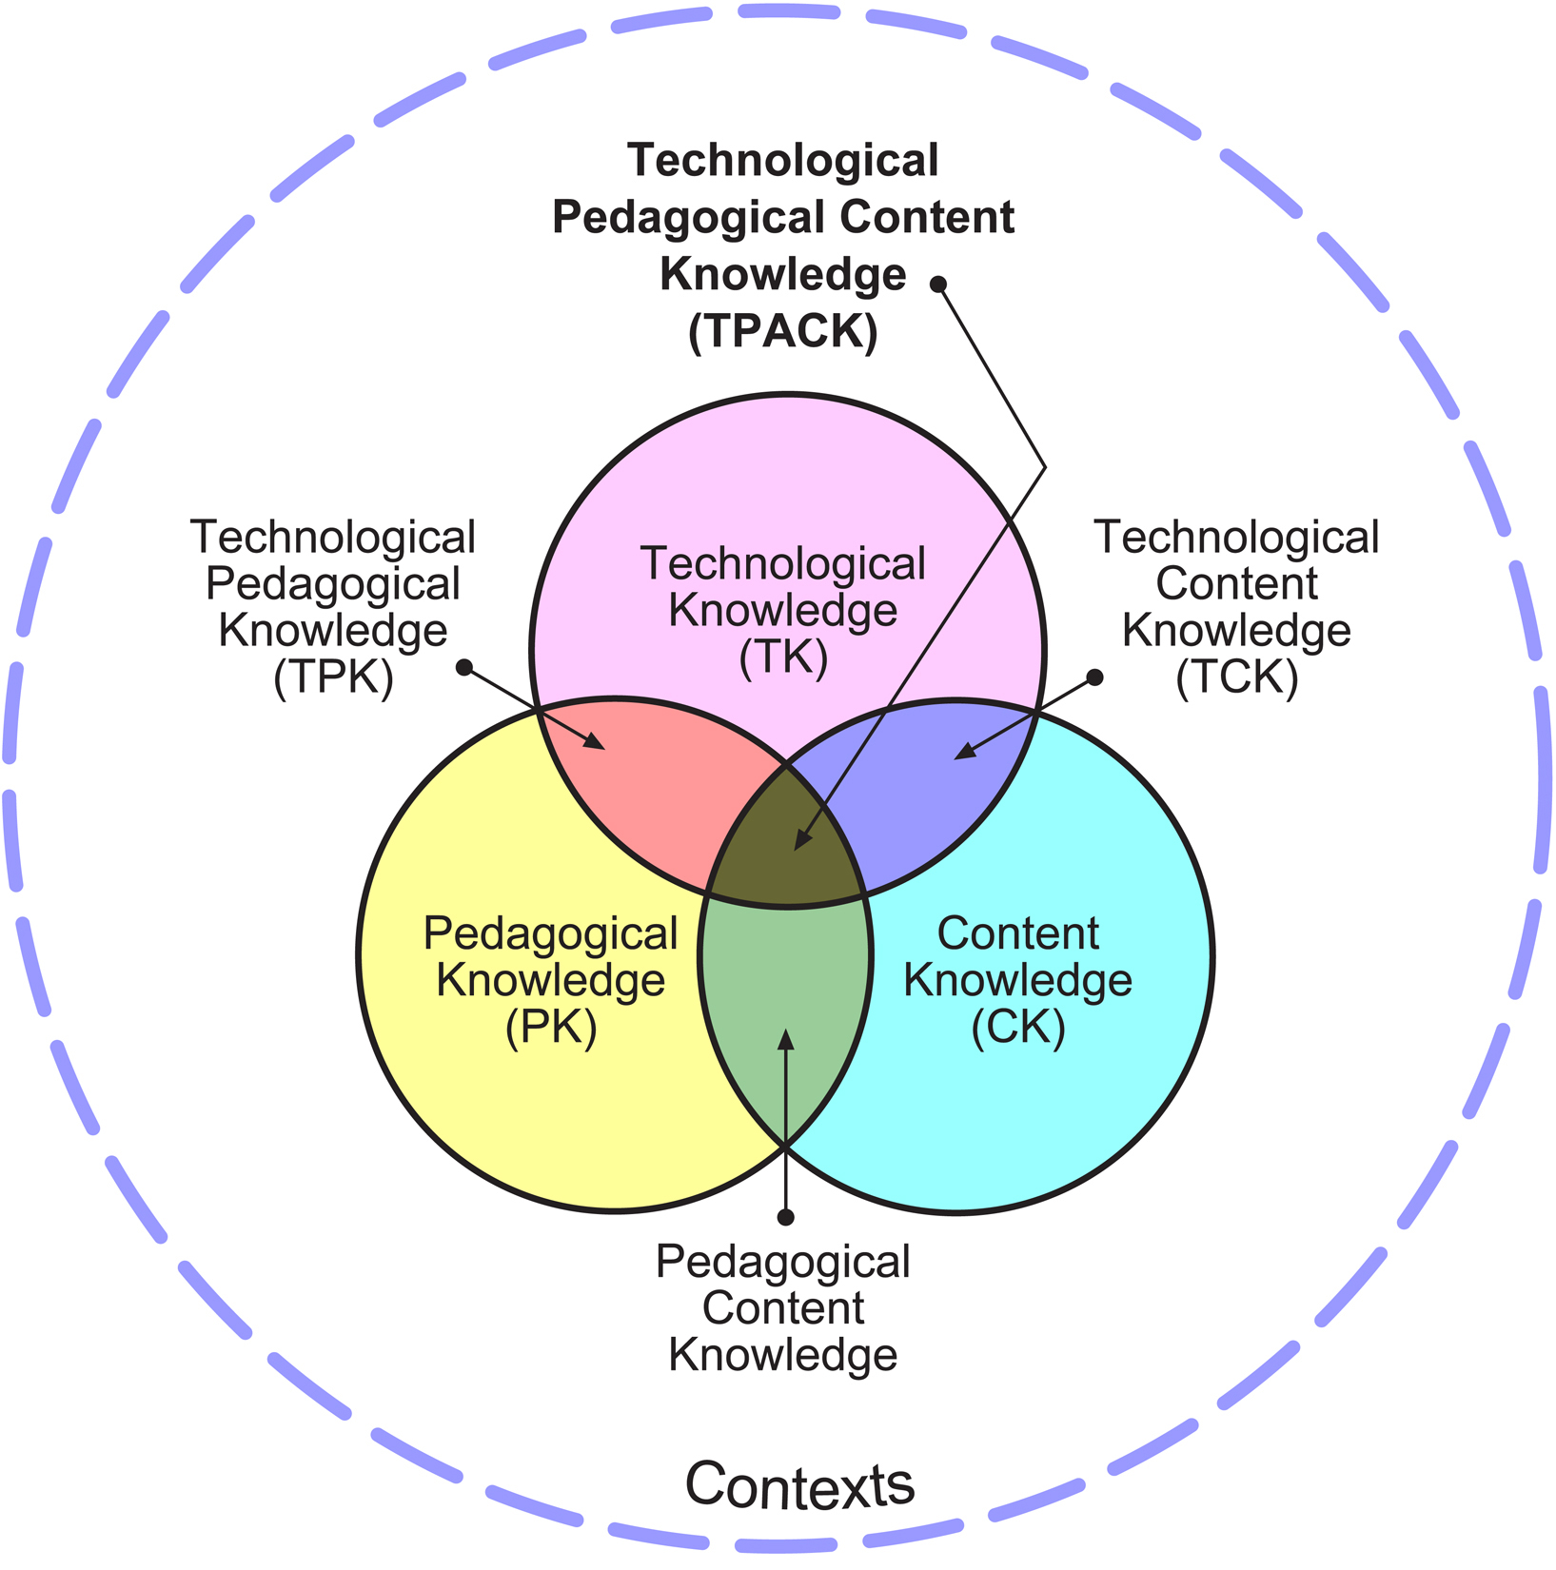

Slide 8
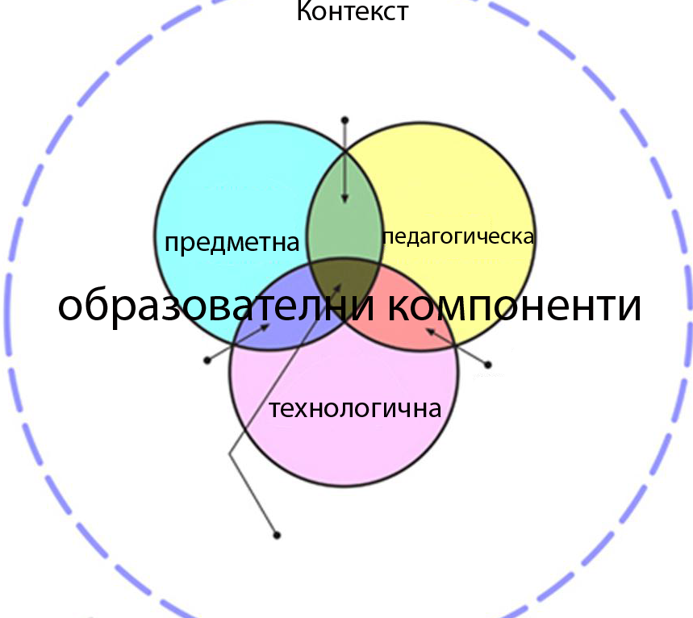
Seen By the author

Slide 9
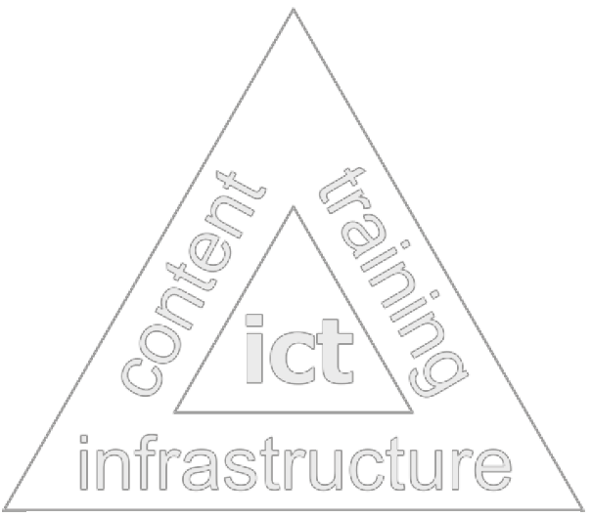
Pillars of education
Educational requirements and standards
  General state requirements - training programs, educational content, pedagogies, inspection and evaluation of knowledge
    Classroom education
    Distance education
    Blended education
    Continuing education
    Vocational education
    Create professional communities in various areas of education
    The use of innovative pedagogies
Network infrastructure
  Supporting internal network
  Backbone connections to European and global networks
  Information-resource environment
Storage systems
Educational cloud
  University ICT infrastructure level campus
  School ICT infrastructure
  Administrative ICT infrastructures in education
  Electronic educational resources
Systems of Knowledge Management
  Authors studios for the creation of electronic content
  test systems
Electronic educational content
  Educational portals

Slide 10

Information – resource infrastructure

Slide 11
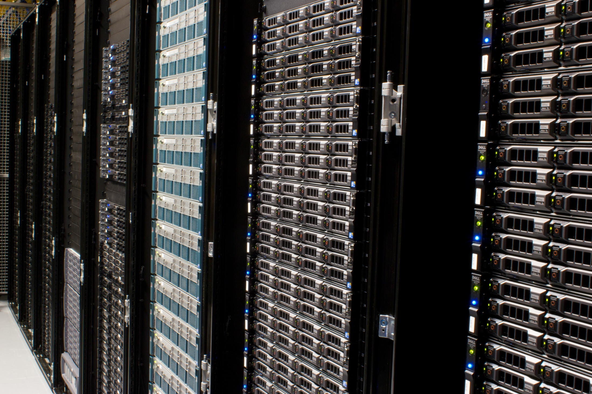
Storage

Slide 12
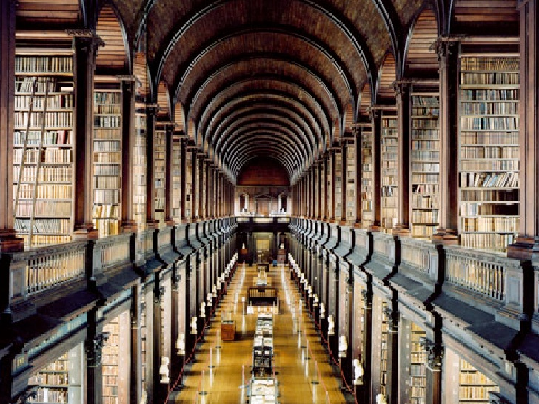

Electronic content

Slide 13
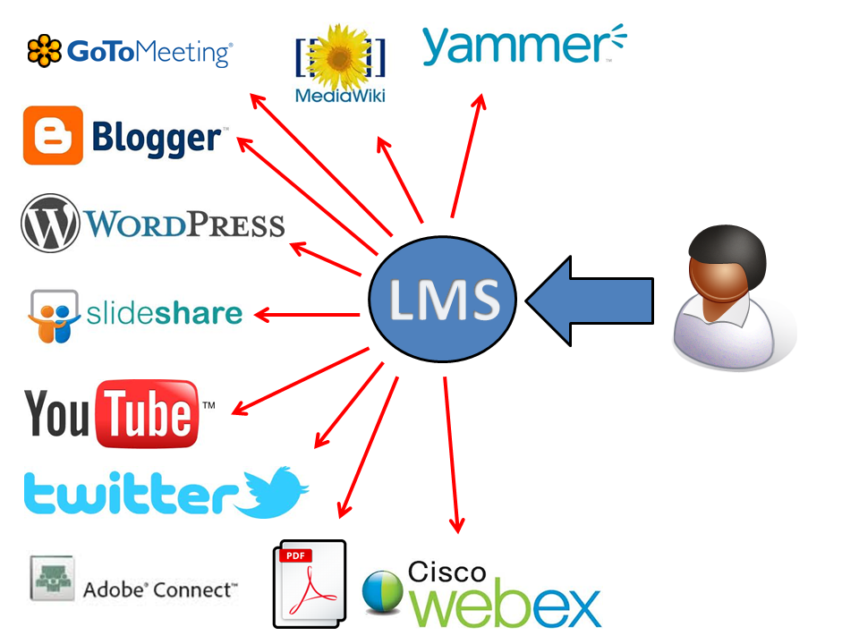

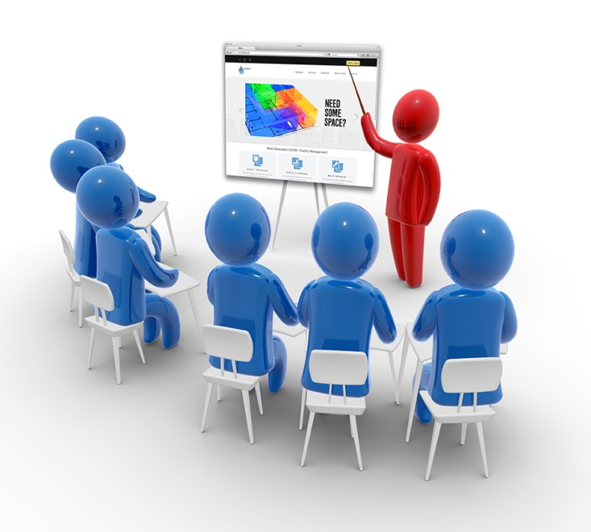
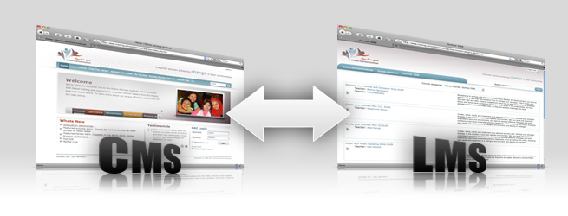

Slide 14
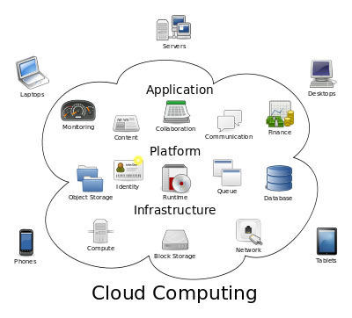

Slide 15
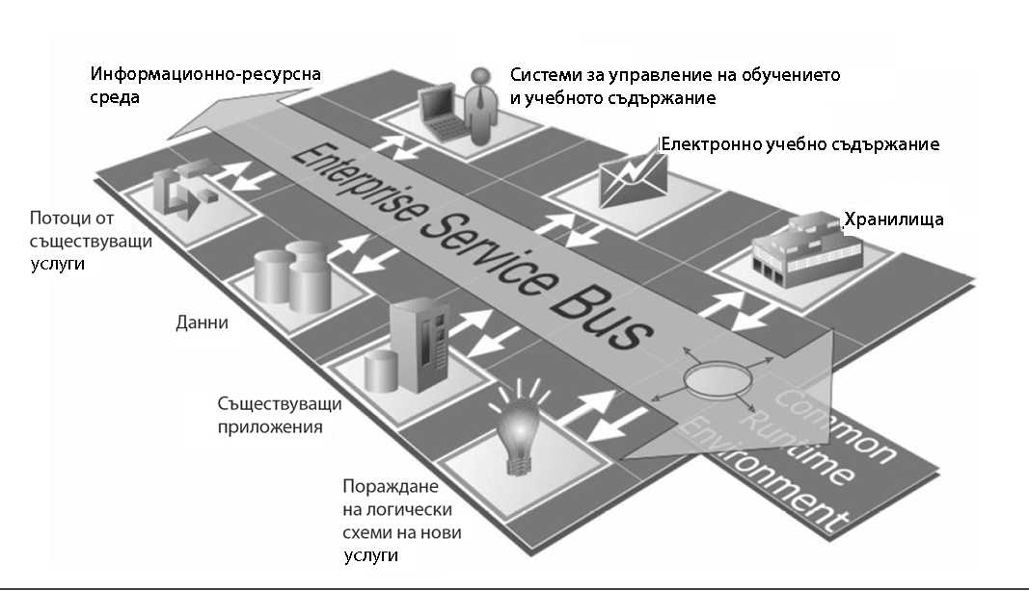
Pillars of e-Education
Information resource environment
Electronic educational content
Streams of
Existing services
STANDARDS
storage
Data
Existing Applioocations
Arrizing of logical schemes and new services

Slide 16
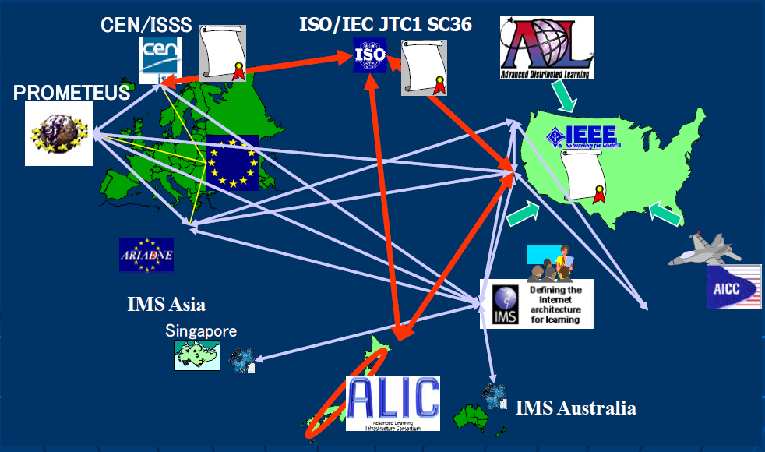
STANDARTISING ORGANIZATIONS

Slide 17
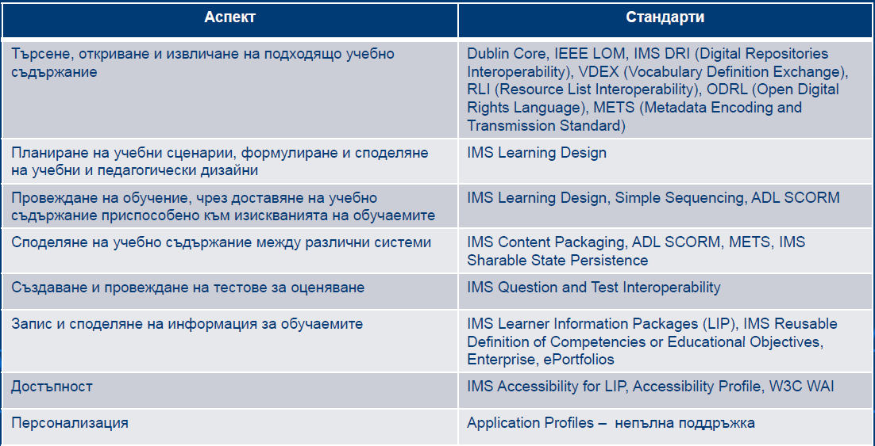
Aspects of Standardisation
Aspects
Standards
Search, discover, retrieval of appropriate educational content
Planning of educational scenarious and sharing of educational and pedagogic design
Education through delivery of education content adapted to the requirements of the learners
Sharing of education content and data for assessment among different systems
Recording and sharing of information between the learners
Accessibility
Personalization

Slide 18
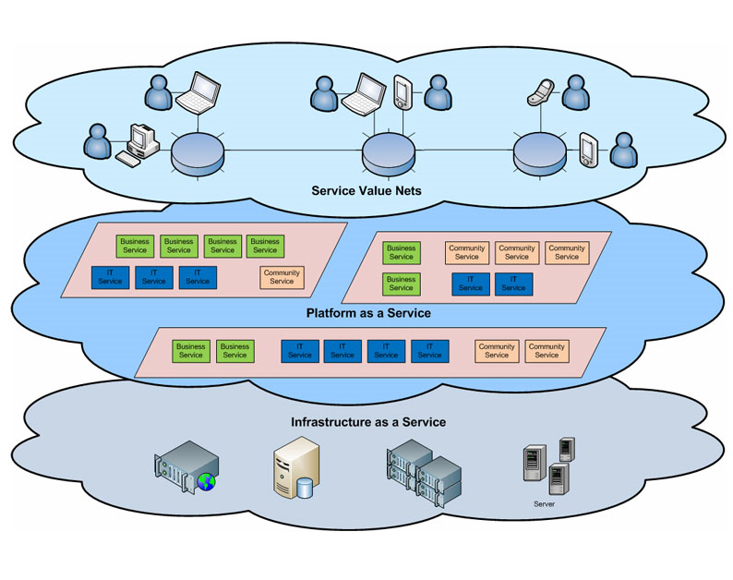

Slide 19
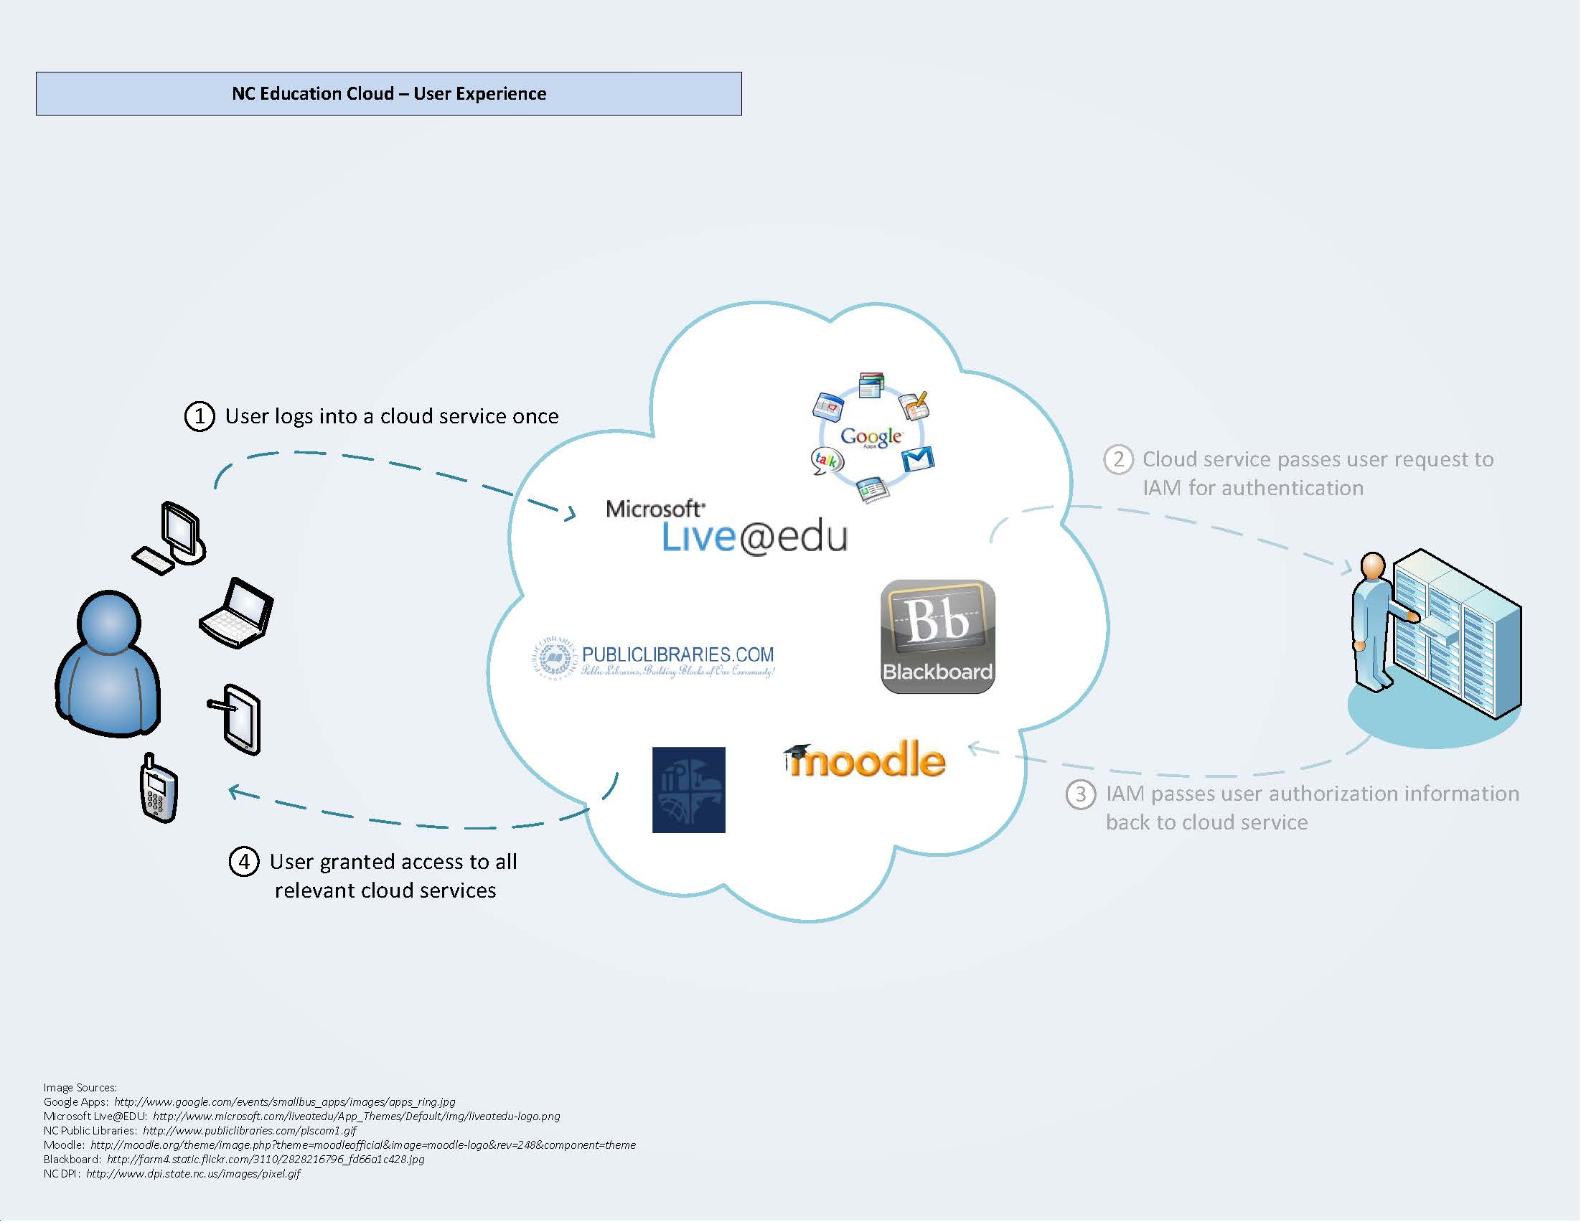

Slide 20
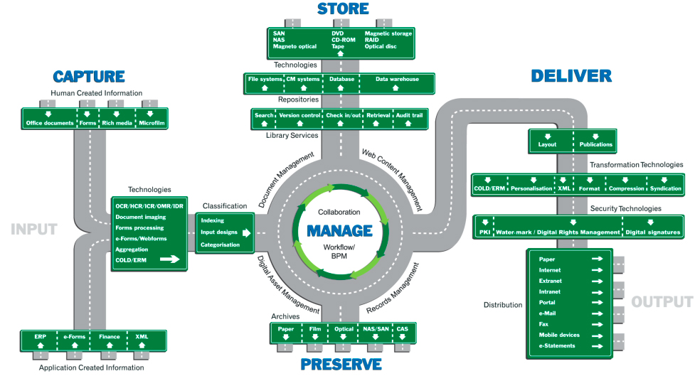
Processes

Slide 21
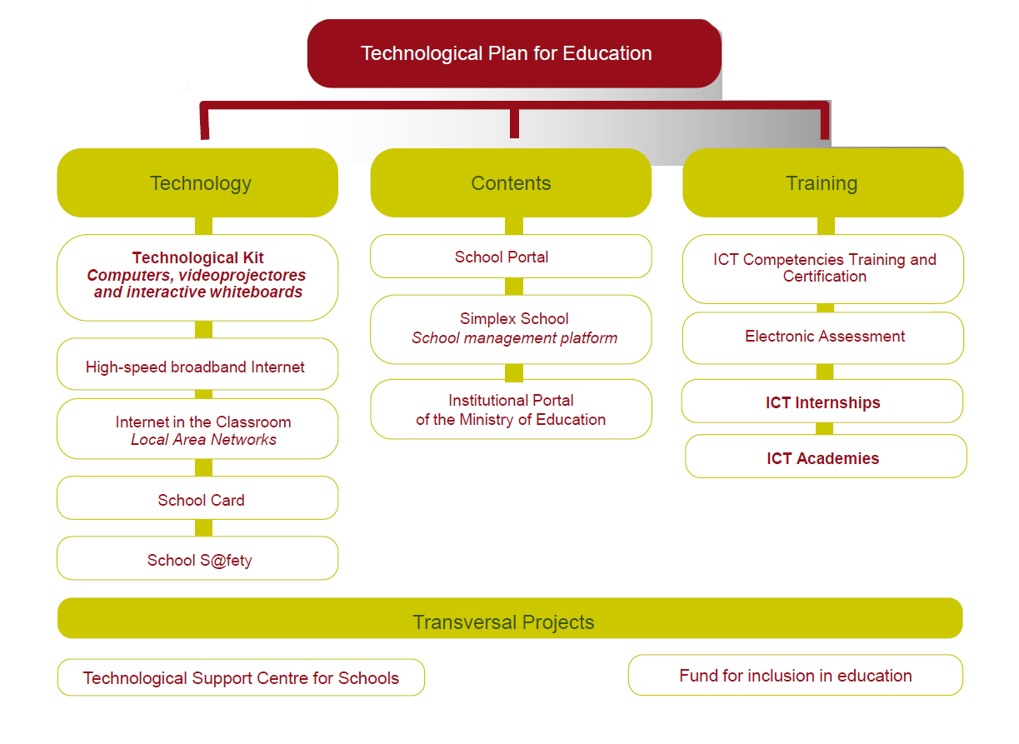

Slide 22
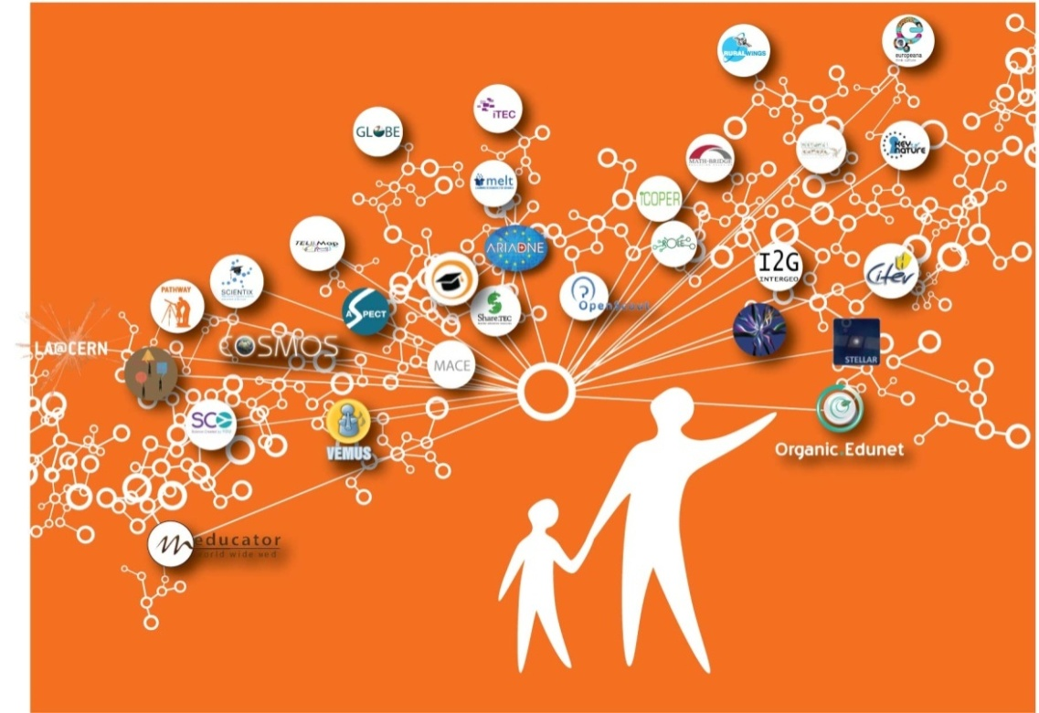
Thanks for your attention !
Assoc. Prof. Radoslav Yoshinov PhD
Bulgaria , Sofia 1113
Acad. G. Bonchev str., Block 8
Laboratory of Telematics - BAS /Director;
Tel. +359 2 979 2896
Mobile +359 888 627190
www.cc.bas.bg; www.bren.bg
Questions?

