Slide 1




The AICA proposal for Computing
in Italian Primary and Lower Secondary Schools

Slide 2
Computing: so many aspects
Digital competence
(digital literacy)
Computational thinking
Promoting talented people
eLeadership
(Digital for innovation)
Teaching & Learning
in digital environment
Digital competences
for specific jobs
Professional Informatics
competences

Slide 3
Computing: so many aspects
Digital competence
(digital literacy)
Computational thinking
Promoting talented people
eLeadership
(Digital for innovation)
Teaching & Learning
in digital environment
Digital competences
for specific jobs
Professional Informatics
competences

Slide 4
Computing: so many aspects
Digital competence
(digital literacy)
Computational thinking
Promoting talented people
eLeadership
(Digital for innovation)
Teaching & Learning
in digital environment
Digital competences
for specific jobs
Professional Informatics
competences

Slide 5
Computing: so many aspects
Digital competence
(digital literacy)
Computational thinking
Promoting talented people
eLeadership
(Digital for innovation)
Teaching & Learning
in digital environment
Digital competences
for specific jobs
Professional Informatics
competences

Slide 6
Computing: so many aspects
Digital competence
(digital literacy)
Computational thinking
Promoting talented people
eLeadership
(Digital for innovation)
Teaching & Learning
in digital environment
Digital competences
for specific jobs
Professional Informatics
competences

Slide 7
Computing: so many aspects
Digital competence
(digital literacy)
Computational thinking
Promoting talented people
eLeadership
(Digital for innovation)
Teaching & Learning
in digital environment
Digital competences
for specific jobs
Professional Informatics
competences

Slide 8
Two documents
Digital competence
(digital literacy)
Computational thinking
Digital competence involves the confident and critical use of Information Society Technology for work, leisure and communication. It is underpinned by basic skills in ICT: the use of computers to retrieve, assess, store, produce, present and exchange information, and to communicate and participate in collaborative networks via the Internet”
(European Parliament Recommendation 2006)
“Computer science deals with the theoretical foundations of information and computation, together with practical techniques for the implementation and application of these foundations”
(Wikipedia)

Slide 9

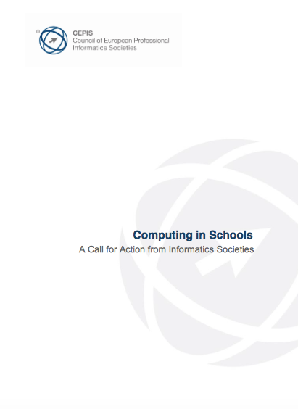
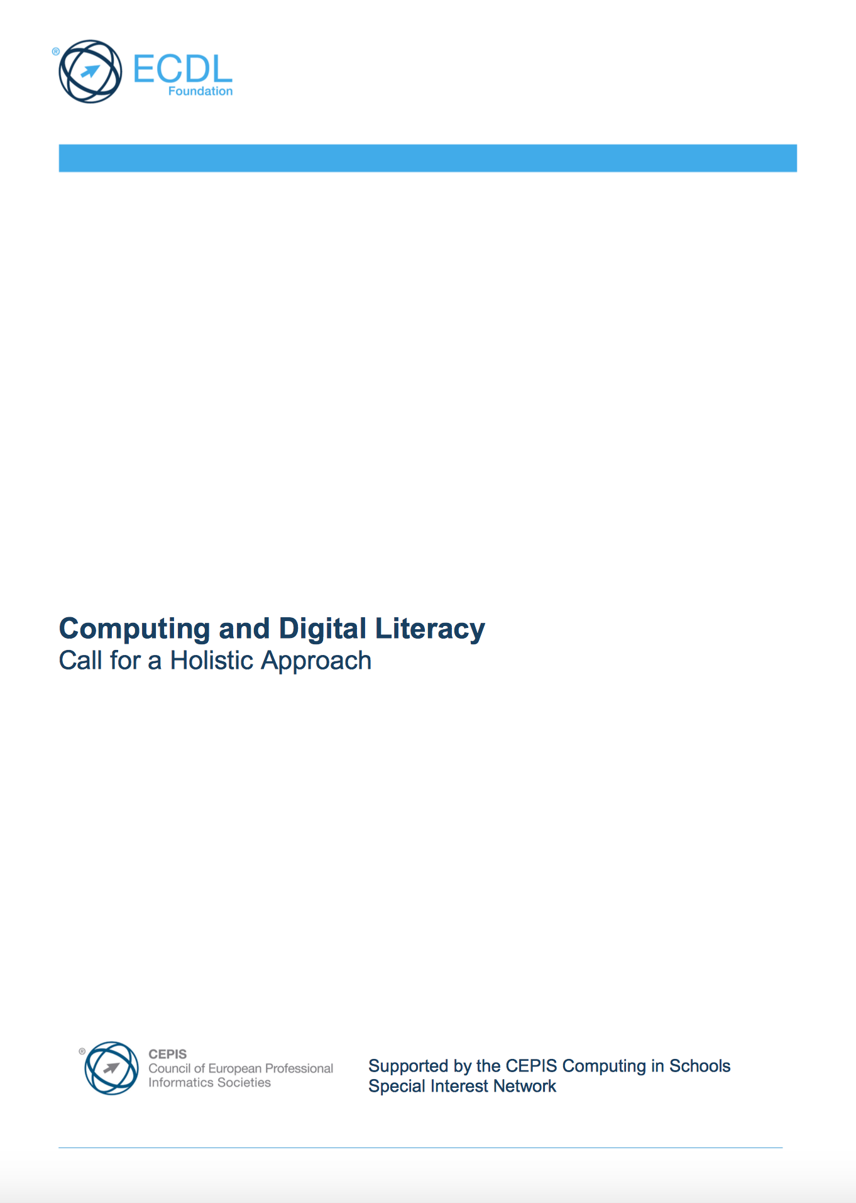
Cepis and Foundation documents

Slide 10
Cepis and Foundation documents
“Immediate action is needed to better integrate Computer Science in the school system and change the perception of computing among young people”.
“The school ICT curricula need to reflect a balance between the development of Digital Literacy and Computer Science”.

Slide 11


Why Computational thinking?
1. The problem solving value
Piaget
Papert

Slide 12
Why Computational thinking?
2. The STEM value

Slide 13

Why Computational thinking?
3. The “creativity” value

Slide 14
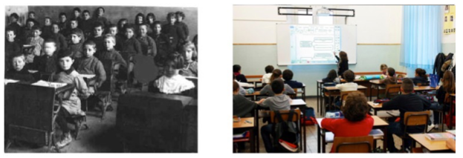
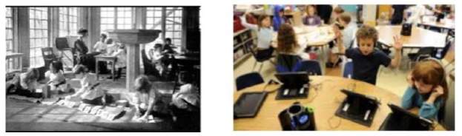
Why Computational thinking?
4. The value for future workers

Slide 15
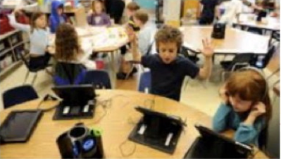
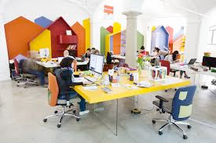
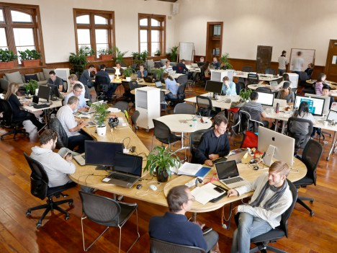
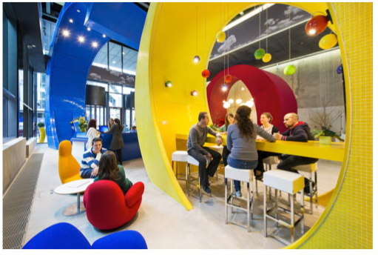
Why Computational thinking?
4. The value for future workers

Slide 16
LOGIC
A proposal AICA - ANFOR for pre-Primary, Primary & lower Secondary Schools
Focus on pedagogical teachers training

Slide 17
LOGIC Modules
Mod A
Pedagogical theories
(Teachers)
Mod B
Algorithms &
Problem solving
(Students)
Mod 1
Bee bot
Mod 2
Drape
Mod 3
Logo
Mod 4
Robomind
Mod 5
Snap! by Scratch

Slide 18
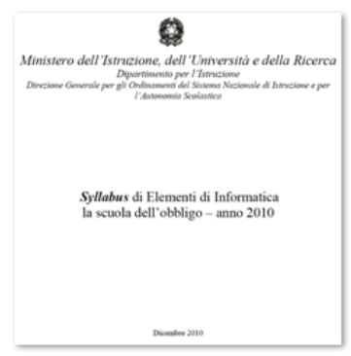
Module A: Pedagogical theories
Mod A
Pedagogical theories
(Teachers)

Slide 19
Module B: Algorithms & PS
Mod B
Algorithms &
Problem solving
(Students)

Slide 20
Module 1: Bee bot
Mod 1
Bee bot

Slide 21
Module 2: Drape
Mod 2
Drape

Slide 22
Module 3: Logo
Mod 3
Logo

Slide 23
Module 4: Robomind
Mod 4
Robomind

Slide 24
Module 5: Snap! by Scratch
Mod 5
Snap! by Scratch

Slide 25

Teacher Certificate
Mod A
Pedagogical theories
(Teachers)
Mod B
Algorithms &
Problem solving
(Students)
Mod 1
Bee bot
Mod 2
Drape
Mod 3
Logo
Mod 4
Robomind
Mod 5
Snap! by Scratch
3 modules
by choice

Slide 26

Expert Certificate
Mod A
Pedagogical theories
(Teachers)
Mod B
Algorithms &
Problem solving
(Students)
Mod 1
Bee bot
Mod 2
Drape
Mod 3
Logo
Mod 4
Robomind
Teacher certificate
+
Module A
Mod 5
Snap! by Scratch

Slide 27

Student Certificate
Mod A
Pedagogical theories
(Teachers)
Mod B
Algoritmi e Problem solving
(Studenti)
Mod B
Algorithms &
Problem solving
(Students)
Mod 1
Bee bot
Mod 2
Drape
Mod 3
Logo
Mod 4
Robomind
2 by choice
+
Module B
Mod 5
Snap! by Scratch

Slide 28
Thank you for the attention
Pierfranco Ravotto
p.ravotto@aicanet.it
CreativeCommons: Attribution – Share alike.
You are free to use, modify and distribute this presentation citing the original author and leaving the same rights on the resulting product.

